Slide 1
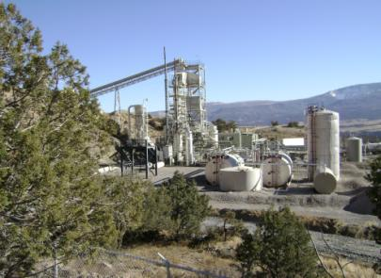
Paraho IITM technology selection
High availability
High oil yields
Energy & thermally efficient
Safe operation
Environmentally sound
Notes:
High Availability
Mechanical simplicity from the vertical, gravity-feed design translates into minimal downtimes and high availability
High Oil Yields
Operationally flexible allowing for steady retorting operations and consistent high oil yields
Energy Efficiency
High thermal efficiency allows for better capture and re-use of generated process heat, resulting in overall lower operating costs
Safe Operation
The low pressure, thermally encapsulated process with few moving components is safe to operate
Environmentally Sound
Thermal extraction process generates typical waste streams that are easily manageable with current emissions control technologies

Slide 2
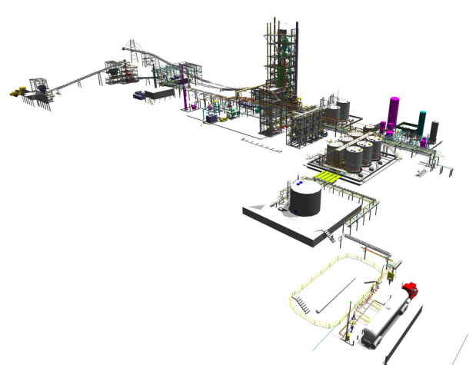
End to end technology demonstration plant
Screening/sizing
Fines Briquetting
Retort
Shale Dryer
Oil Upgrading
Plant Utilities
Crushing Plant
High local and Queensland content in construction.
Employing up to 150 people at the peak of construction.
Oil Storage
Truck Loadout

Slide 3
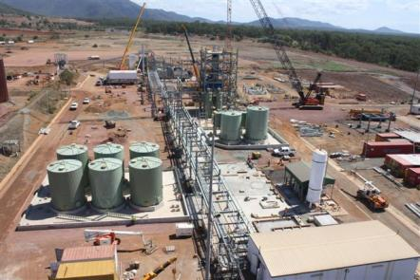
Technology demonstration plant objectives
Demonstrate safe operation
Build community and Government support
Establish environmental credibility
Notes:
Despite being zoned in an industrial area, the waters off Gladstone are zoned as Great Barrier Marine Park. This poses environmental challenges compared to inland mine sites

Slide 4
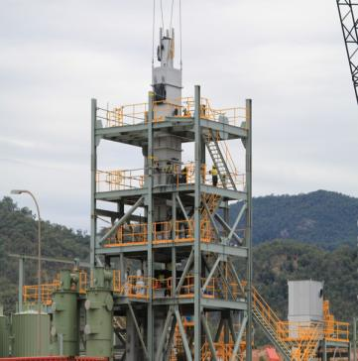
Technology demonstration plant objectives
Develop product market acceptability
Maximise technical development
Test process improvements
Evaluate varying feed properties
Build operational expertise
Notes:
Despite being zoned in an industrial area, the waters off Gladstone are zoned as Great Barrier Marine Park. This poses environmental challenges compared to inland mine sites

Slide 5
Water processing

Slide 6
Gas treatment

Slide 7
Oil upgrading

Slide 8
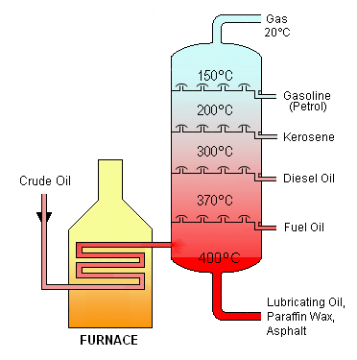
Fractionation
Fractional Distillation: is a physical separation method of a mixture of components (two or more) into pure fractions or cuts by utilising difference in their boiling points, in a vertical cylindrical column interchangeably known as fractionator or distillation column or tower.
This method of distillation is required when boiling points of components in feed mixture are close enough and are less than 25 deg C (at 1atmosphere pressure) to each other. Fractional distillation is similar to simple distillation, except the same process is repeated in successive cycles. Each cycle produces a mixture richer in the more volatile compound than the mixture before it.

Slide 9
Pyrolysis
Pyrolysis is the thermal decomposition of organic material at elevated temperatures in the absence of oxygen. Again the word is derived from Greek elements of “pyr” meaning fire and “lysis” meaning separating. Pyrolysis is not used exclusively for oil shale it is used in a variety of other industries. The process is used heavily in the chemical industry, for example, to produce charcoal, activated carbon, methanol, and other chemicals from wood, to convert ethylene dichloride into vinyl chloride to make PVC, to produce coke from coal, to convert biomass into syngas, to turn waste into safely disposable substances, and for transforming medium-weight hydrocarbons from oil into lighter ones like gasoline. These specialized uses of pyrolysis may be called various names, such as dry distillation, destructive distillation, or cracking.
So, in simple terms, when the kerogen within the shale is heated without oxygen it decomposes into bitumen (called pyrolytic bitumen) and further heating converts this bitumen into oil, hydrocarbon gas and a carbon like char that remains on the shale afterwards. The figure below shows this progression from kerogen to oil, gas and char over time when pyrolysed at 748 Kelvin (or 475°C).

Slide 10
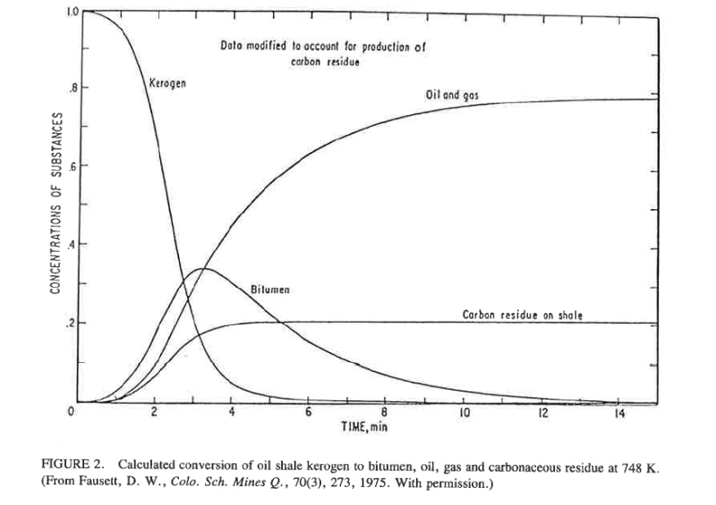

Slide 11
Hydrogen Production
Steam Methane Reforming: The steam methane reformer utilises natural gas as feedstock. Methane and other hydrocarbons in natural gas are converted into hydrogen and carbon monoxide by reaction with steam over a nickel catalyst. The SMR process is a two step process; first reformation of natural gas, and secondly shift reaction.
In first step of natural gas reformation of SMR process, methane reacts with steam at a high temperature of about 750-800 deg C to produce synthesis gas (syngas). Syngas is a mixture of mainly hydrogen and carbon monoxide.
CH₄ + H₂O → CO + 3H₂ (+191.7 kJ/mol)
The second step is a the water gas shift (WGS) reaction. In this step, the carbon monoxide produced in first reforming reaction step is reacted with steam over a catalyst to form more hydrogen and carbon dioxide. This process occurs in two stages, consisting of a high temperature shift (HTS) at 350C and a low temperature shift (LTS) at 190-210C.
CO + H₂O → CO₂ + H₂ (- 40.4 kJ/mol)

Slide 12
Wastewater Treatment
In industry, wastewater is generated from numerous sources, and its nature depends on the specific industry. No two wastewaters are ever the same. The objectives of the wastewater treatment plant also vary; sometimes the water is treated to a standard suitable for discharge to a river or the sea. Sometimes it receives pre-treatment to make it suitable to discharge to a sewer system, and sometimes it is treated to a quality suitable for recycling and re-use, either within the same premises or at another nearby water user.
Process water from oil shale retorting is contaminated with ammonium, carbon dioxide, and hydrogen sulphide. These can be removed from the water phase into a gas phase by a process known as stripping. The water is first heated to above 100ºC, but under pressure to prevent the water boiling. The water then flows down through a tower or column filled with media. The media helps the contact between the water flowing down, and steam bubbles flowing up the column. By having intimate contact between the gas and liquid phases, the dissolved sulphide and ammonia gasses can be persuaded to move from the liquid phase to the gas phase. Increasing the water temperature helps as gas becomes less soluble at high temperature.

Slide 13
Biological Treatment
There are many ways in which micro-organisms are employed to treat wastewater. The first biological sewage treatment works were constructed in the 19th century in London, and the science has evolved since then into a proliferation of different processes. They all have the same aim – to stabilise and remove the contaminants from the wastewater. The microbes are essentially living catalysts for the conversion of chemicals in the water from one state to another. They gain energy and grow by feeding on the contaminants in the same way as we eat food.
Biological processes can either be oxidative, converting ammonia and carbon into CO₂, nitrate and water, or reductive, producing methane, nitrogen and H₂S.
The choice of biological process for shale oil process water has yet to be made. If the water is first stripped of ammonia and H₂S, anaerobic treatment may be suitable. If it is not stripped, then aerobic treatment is required to remove the ammonia and H₂S. Trials will be carried out to determine the best treatment for the full scale works.

Slide 14
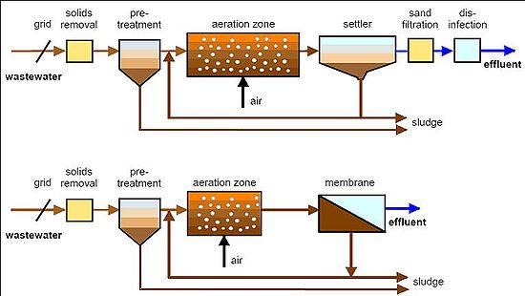
Activated Sludge biotreatment

