Slide 1
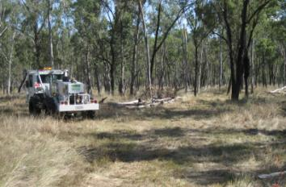
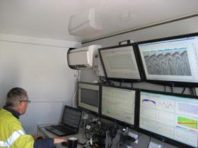
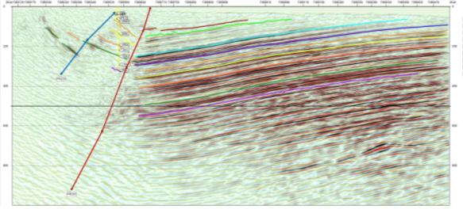
Geophysics - Seismic Survey
Geophysics – uses density contrast properties of the rock sequence to image layering and structure

Slide 2
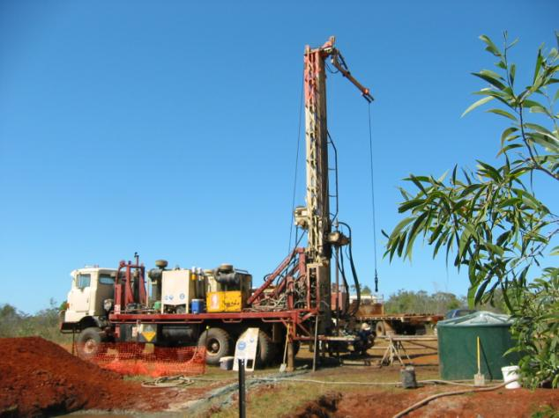
Drilling

Slide 3
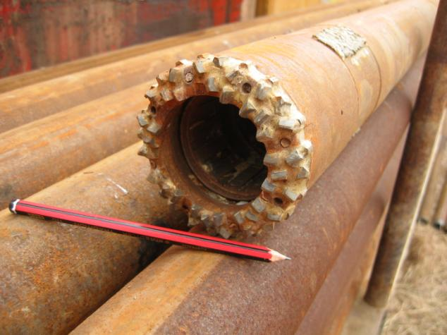
Drilling – Core Recovery

Slide 4
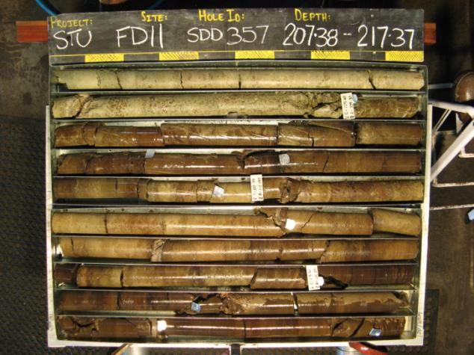
Core Sampling and Oil Yield Assays

Slide 5
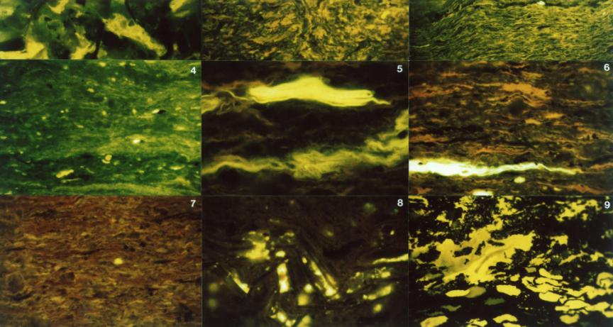
Kerogen
Lamalginite, 2 – 20% of the rock, laminar material
0.002mm thick and 0.02 – 0.05mm long

Slide 6
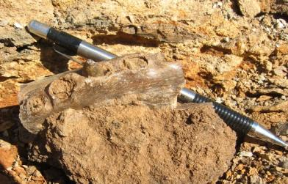
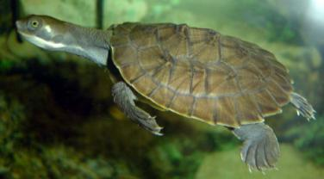
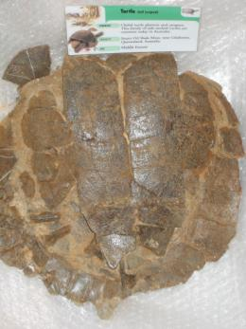
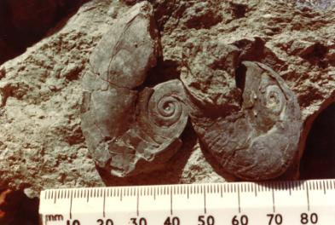
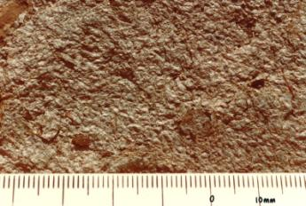
Fossils
Vertebrates - Turtles, crocodiles
Shell fragments – snails, ostracodes

Slide 7
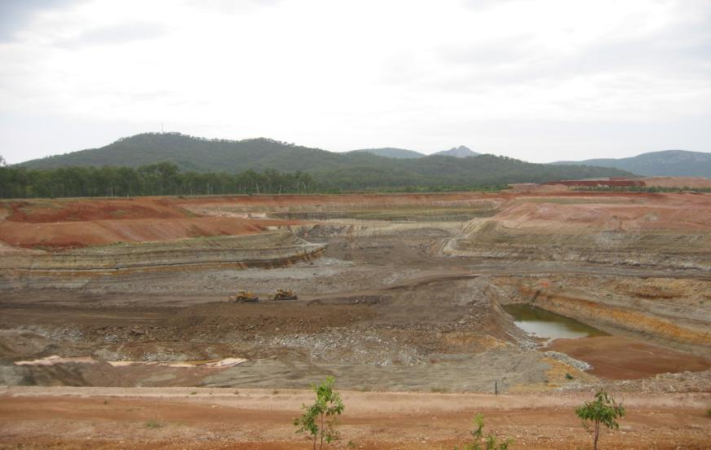
STUART oil shale mine 2003

Slide 8
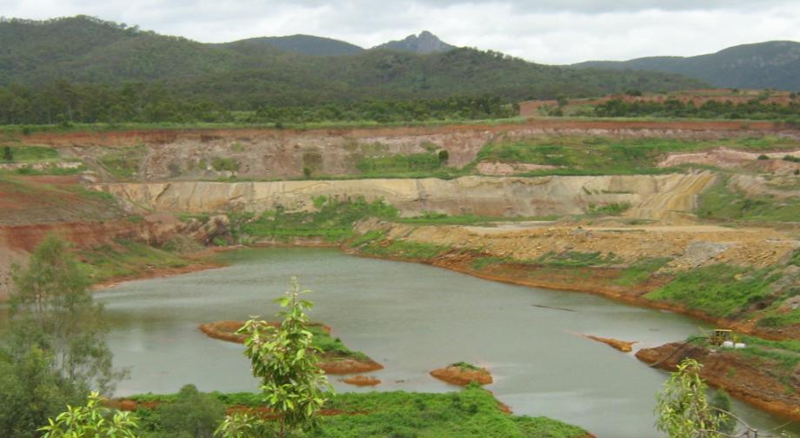
STUART oil shale mine 2010

